Slide 1
SURGICAL PRINCIPLES OF PERIPHERAL NERVE REPAIR

Slide 2
Introduction
Peripheral nerves are the neural structures that connect CNS to the end organs
PNS consists of:
  12 pairs of cranial nerves
  31 pairs of spinal nerves
Unique power of regeneration

Slide 3
Etiology of nerve injury
Three major causes:
  Medium to high energy nerve injuries
  Low energy compressive or ischemic lesions
  Complex injuries

Slide 4
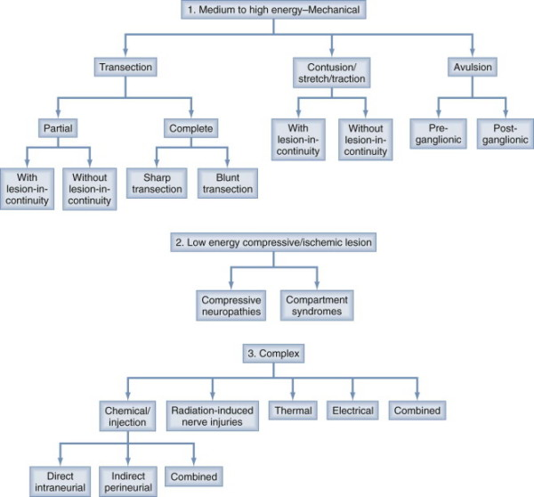

Slide 5
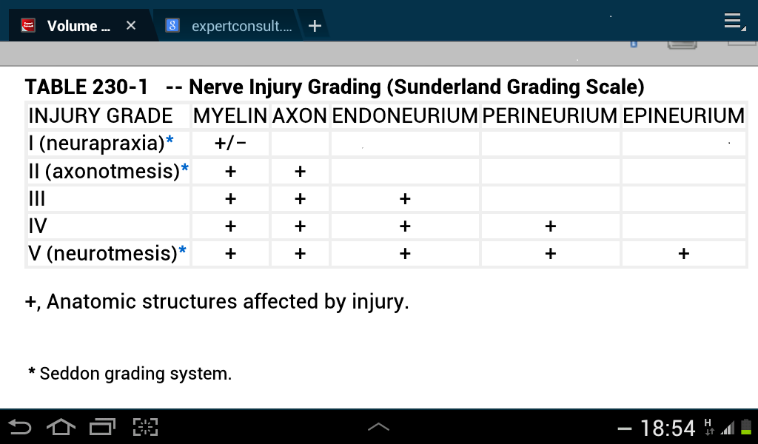
Classification

Slide 6
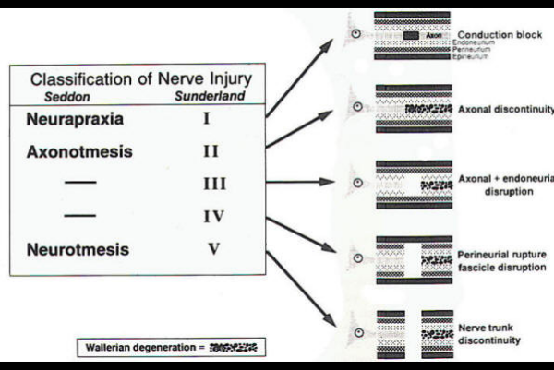
http://www.neurosurgery.tv/wallerian.html

Slide 7
Approach to the patient
History: pain, sensory loss, weakness
Clinical examination: general, inspection, joint mobility, motor & sensory testing, autonomic testing & special tests
Electrophysiology: NCV, EMG
Imaging
Notes:
Pain: 4 types- disuse related, autonomic, avulsion, regeneration related pain
General exam: full exposure
Inspection: atrophy, limb position, scar, sweating, hair loss, erythema
Joint mobility: to exclude non neurological causes of joint immobility
Motor & sensory
Autonomic tesing: eg, horners syndrome in BPI
Special tests: hoffman tinel sign, phalen’s test
NCV: conduction velocity- slowing indicates demyelination; amplitude- decrease indicates axonal damage
EMG: acute denervation- fibrillation potential, positive sharp wave; chronic denervation- complx repetitive discharges

Slide 8
Time of intervention
Changes following nerve injury:
  Central cell death, ischemia & fibrosis
  Target organ changes: muscle atrophy & disappearance of motor end plates- irreversible with time
  Proximal injury- worse outcome

Slide 9
Time of intervention: early
Early nerve repair prevents neuronal loss & improves outcome
Ma J, Novikov LN, Kellerth JO, Wiberg M: Early nerve repair after injury to the postganglionic plexus: an experimental study of sensory and motor neuronal survival in adult rats. Scand J Plast Reconstr Surg Hand Surg 2003; 37:1-9.
With exception of spinal accessory improved results of early repair are found in median, ulnar, radial, musculocutaneous, sciatic, CPN & closed traction BPI
Merle M, Amend P, Cour C, et al: Microsurgical repair of peripheral nerve lesions: a study of 150 injuries of the median and ulnar nerves. Peripher Nerve Repair Regen 1986; 2:17-26.
Birch R, Raji AR: Repair of median and ulnar nerves. Primary suture is best. J Bone Joint Surg Br 1991; 73:154-157.
Kato N, Htut M, Taggart M, et al: The effects of operative delay on the relief of neuropathic pain after injury to the brachial plexus: a review of 148 cases. J Bone Joint Surg Br 2006; 88:756-759.
Limiting factor for early repair: difficult to determine the extent of stump resection

Slide 10
Primary repair: urgent surgery
Operations done within 3-5 days of injury
Indication: sharp transection
Contraindication: poor clinical condition
Adv:
  Scar free field
  Minimal intraneural scarring-less distortion of intraneural architecture- proper fascicular matching
Disadvantage : EPS may not be available or feasible

Slide 11
Delayed primary repair
Done after 2-3 weeks
Good outcome
Advantages of primary surgery disappears

Slide 12
Secondary repair
Performed between 3 weeks to 3 months
Indications: neuroma in continuity
Adv: 40% of BPI recovers spontaneously- prevents unnecessary surgery
Disadvantage : exploration in scarred tissue & intraneural scarring & distortion

Slide 13
Indications for surgery
Paralysis after trauma over the course of a major nerve- including iatrogenic injuries
Paralysis following closed traction BPI
Associated vascular or orthopedic injury requiring treatment
Worsening or failure to improve within expected time period
Persistent pain

Slide 14
Contraindications
Poor general condition of the patient
Uncertainty about viability of the nerve trunks
Local & systemic sepsis
Early signs of recovery

Slide 15
Types of surgery
Primary procedures
Alternative methods
Secondary procedures

Slide 16
Alternative procedures
Direct muscular neurotization
Nerve conduits
Interposed freeze-thawed muscle
Nerve allograft repair
Central repair

Slide 17
Secondary procedures
Tendon transfer
Functioning free muscle transfer
Arthrodesis
Tenodesis
Corrective osteotomy
Amputation

Slide 18
Principles of nerve repair
Environment: generous operative field, good illumination, microscope or loupe
Anesthesia: Short acting paralyzing agent
Flexibility regarding the position of surgeon & limb

Slide 19
Principles of nerve repair
Wide exposure
Sharp dissection in anatomic planes starting from virgin tissues & progressing towards the lesion
Meticulous hemostasis- bipolar cautery
Preserving fat & synovium planes- nerve’s gliding planes-
  The gliding apparatus of peripheral nerve and its clinical significance. Millesi H, Zoch G, Rath T. Ann Chir Main Memb Super 1990;9(2):87-97.

Slide 20
Principles of nerve repair
Preparing nerve stumps:
  Circumferential exposure
  Generous proximal & distal mobilization
  External neurolysis
  Use of intra-operative electro-physiology
  Placement of lateral stay sutures (6-0)- to maintain topographic alignment
Notes:
Fascicles pout because of positive endoneural pressure

Slide 21
Debridement of nerve stumps proximally & distally to remove scar tissue-
scar > scar with some fascicles > pure healthy fascicles (fascicles appear to pout, glossy surface & fine bleeding from vessels)

Slide 22
Principles of nerve repair
Proper alignment & positioning of nerve stumps & grafts:
  Longitudinal vessel alignment in epineurium
  Fascicular alignment

Slide 23
Principles of nerve repair
Proper suturing:
  Material: 8-0, 9-0 or 10-0 monofilament nylon
  Two lateral sutures 180⁰ apart
  Three to four more sutures may also be placed
  Tensionless
  Avoid overzealous suturing- every suture induces fibrosis

Slide 24
Principles of nerve repair
Use of fibrin glue:
  Secures the position of anastomosis
  When used alone: does not provide tensile strength or permit to fish-mouth
  Clump formation to be avoided

Slide 25
Decompression
Release of a nerve from external compression
Types:
  Open
  Endoscopic

Slide 26
Neurolysis
Release of nerve or its part from organized scar
Types:
  External
  internal
External neurolysis:
  Nerve is set free from scar, organized hematoma or bony fragments
  Released in circumferential manner
  Epineurium is minimally breached

Slide 27
Neurolysis
Internal neurolysis:
  Opening or resection the external epineurium to lyse internal scar
  Plain of dissection: internal epineurium
  Not to damage perineurium
  Used for preparation of nerve ends for grafting, dissection of neuroma in continuity & benign nerve sheath tumor

Slide 28
Direct repair
Possible in most clean lacerating injuries & when co-aptation can be done without undue tension
Types:
  Epineural repair
  Grouped fascicular repair
  Fascicular or perineural repair
Combination of epineural & grouped fascicular repair- most commonly used

Slide 29
Epineural repair
Traditional method
Appropriate for monofascicular & diffusely grouped polyfascicular nerve
Goal: tensionless coaptation of proximal & distal fascicular anatomy

Slide 30
Epineural repair
Small bite taken from internal & external epineurium
Perineurium avoided
Tied with mild to moderate tension
Disadvantage: precise matching of proximal & distal fascicles may not be possible
Notes:
When fresh epineurium glides over it contents hence bite should also be taken of the internal epineurium. In late cases however fibrosis prevents this gliding.

Slide 31
Grouped fascicular repair
Indication:
  Group of fascicles with specific functions- sensory or motor
  Nerve requiring split repair
Debridement & alignment
Inter-fascicular dissection- within internal epineurium
Suturing through internal epineurium and perineurium

Slide 32
Fascicular repair
Indication:
  Lacerated nerve with identifiable individual motor & sensory fascicles
  Partial injury to 1-2 fascicles
Repair under high magnification with 10-0 nylon
Sutures placed through perineurium
Avoid endoneurium
Maximum 2 sutures for each fascicle
Strengthening by addition of epineural sutures

Slide 33
Epineural vs perineural sutures
  Perineural suture is better & epineural suture is the main source of infiltration- Millesi H: Interfascicular nerve grafting. Orthop Clin North Am 1981; 12:287-301.
  Epineural suture is easier & faster- Orgell M: Epineurial versus perineurial repair of peripheral nerves. In: Tertzis J, ed. Microreconstruction of Nerve Injuries, London: Saunders; 1987:97-100.
  Restriction of perineural sutures to oligofascicular nerves: Kline D, Hudson A, Spinner R, et al: Kline & Hudson's Nerve Injuries: Operative Results for Major Nerve Injuries, Entrapments and tumours. 2nd ed. Philadelphia, Saunders, 2008.
  No discernable difference- Urbaniak J R. Fascicular nerve suture. Clin Orthop Relat Res. 1982 Mar;(163):57-64.

Slide 34
Nerve auto graft repair
Indication: direct repair not possible without undue tension
Principles:
  Harvest as much of graft as possible
  Extremity to be in full extension
  Proper alignment: proximal nerves- spatial matching & distal nerves- anatomic matching
  Cable grafting
  Epineural dissection to create group of fascicles
Notes:
Graft should be 10% longer than gap

Slide 35
Nerve auto graft repair
  Graft sutured in epineural & interfascicular epineural technique
  Fish mouth configuration
  1-2 sutures reinforced with fibrin glue

Slide 36
Nerve | Location | Deficit | Contraindication
LACN | Terminal sensory branch of MCN. Located just lateral to biceps tendon in subcutaneous tissue. | Loss of sensation over lateral aspect of forearm | Median nerve injury- significant loss of sensation over dorsolateral thumb
MACN | Derived from medial cord. Closely follows brachial vein. | Loss of sensation over medial forearm | Ulnar nerve injury
SSRN | Terminal sensory part of radial nerve. Lies deep to brachioradialis muscle in proximal forearm. Good graft for proximal radial nerve recon. | Anatomical snuff box | Nil
Sural | Most commonly used donor. Lies deep to deep fascia at proximal leg. Emerge to subcutaneous tissue at midcalf level. Significant contribution from lateral sural branch of peroneal nerve. | Lateral order of the foot | Nil

Slide 37
Harvesting the graft
Methods:
  Open
  Endoscopic
Incision:
  Longitudinal
  Step wise
Proximal division: deep to deep fascia
Cut to produce appropriate length
Notes:
Proximal division: deep to deep fascia to prevent painful neuroma formation
Removal of mesoneurium from the graft to be done

Slide 38
Nerve transfer
Involves re-assigning an expendable or redundant nerve or its part or branch to a more important nonfunctioning nerve
Indications:
  Nerve avulsion
  Rapid & reliable recovery of motor function in post-ganglionic injury
  To power free- functioning muscle transfer
Notes:
Nerve avulsion- procedure of choice

Slide 39
Nerve transfer
Contraindications:
  Absence of donor nerve
  Fibrosed, atrophic recipients
  Repairable rupture or neuroma
  Poor quality donor
Principles:
  Accurate preop documentation & fall- back planning-
  Selection of ideal donor nerve
Notes:
fall- back planning- in case favored donors are poorly functioning

Slide 40
Nerve transfer
  Transection of recipient as proximal as possible
  Dissection of donor distal to the recipient- to gain length
  Selective neurotization based on fascicular anatomy
  Maintaining orientation
  Tension free repair

Slide 41
Alternative methods
Direct muscular neurotization:
  Used when distal nerve stump not available
  Spreading out fascicle in a fan like manner and burying them in intermysial folds
  Becker M, Lassner F, Fansa H, et al: Refinements in nerve to muscle neurotization. Muscle Nerve 2002; 26:362-366.

Slide 42
Interposed freeze-thawed muscle
Basal lamina of muscle acts as scaffold for axonal growth
Problem: axonal growth not target oriented but diffusely over the muscle- Schlosshauer B, Dreesmann L, Schaller HE, Sinis N: Synthetic nerve guide implants in humans: a comprehensive survey. Neurosurgery 2006; 59:740-747.
Promising results for sensory nerve repair-
Pereira JH, Palande DD, Narayanakumar TS, et al: Nerve repair by denatured muscle autografts promotes sustained sensory recovery in leprosy. J Bone Joint Surg Br 2008; 90:220-224.
Notes:
Freeze-thawing is done to destroy all viable biostructure other than basal lamina

Slide 43
Nerve conduits
Tissue engineered bio-artificial tube placed between nerve stumps
Appropriate directional & trophic cues from migrating Schwann cells & soluble growth factors
Inner diameter of tube- 20% larger than that of stumps
Notes:
Conduits provide suitable environment for axonal growth

Slide 44
Nerve conduits
Placement of single microsuture in U fashion
Reinforced with glue
Tube is filled with saline
Good results for defects <3cm in small nerves-
Weber RA, Breidenbach WC, Brown RE, et al: A randomized prospective study of polyglycolic acid conduits for digital nerve reconstruction in humans. Plast Reconstr Surg 2000; 106:1036-1045

Slide 45
Nerve allograft & vascularized nerve grafts
Risk of immunosuppression prevents wide spread use of allografts-
Larsen M, Habermann TM, Bishop AT, et al: Epstein-Barr virus infection as a complication of transplantation of a nerve allograft from a living related donor. J Neurosurg 2007; 106:924-928.Case report
Vascularized nerve graft is useful only in contralateral C7 transfer with interposition ulnar vascularized nerve graft- Birch R, Dunkerton M, Bonney G, Jamieson AM: Experience with the free vascularized ulnar nerve graft in repair of supraclavicular lesions of the brachial plexus. Clin Orthop Relat Res 1988; 237:96-104.

Slide 46
Central repair
Central repair: reimplantation of avulsed spinal nerve-
Birch R, Bonney G, Parry CW: Reimplantation of avulsed spinal nerves. Surgical Disorder of the Peripheral Nerves, London: Churchill Livingstone; 1998:201-207.
Functional benefits have been observed in some cases-
Carlstedt T, Grane P, Hallin RG, Noren G: Return of function after spinal cord implantation of avulsed spinal nerve roots. Lancet 1995; 346:1323-1325.
Carlstedt T, Anand P, Hallin R, et al: Spinal nerve root repair and reimplantation of avulsed ventral roots into the spinal cord after brachial plexus injury. J Neurosurg 2000; 93(suppl):237-247.
Carlstedt T: Central Nerve Plexus Injury. London, Imperial College Press, 2007.
Carlstedt T, Hultgren T, Nyman T, et al: Cortical activity and hand function restoration in a patient after spinal cord surgery. Nat Rev Neurol 2009; 5:571-574.
Should be done within 6 weeks of injury- anterior horn cells become dead after 6 weeks of avulsion- Fournier HD, Mercier P, Menei P: Repair of avulsed ventral nerve roots by direct ventral intraspinal implantation after brachial plexus injury. Hand Clin 2005; 21:109-118.
Fournier HD, Mercier P, Menei P: [Spinal repair of ventral root avulsions after brachial plexus injuries: Towards new surgical strategies?]. Neurochirurgie 2006; 52:357-366.

Slide 47
Secondary procedures
Indications:
  To provide additional function
  Delay between injury & presentation
  Improvement following previous procedure is less than satisfactory
Unlike primary procedures these are time- independent

Slide 48
Tendon transfers
Principles:
  Maintenance of tissue equilibrium- correction of contractures, joint stiffness etc
  Availability: removal of donor should not compromise existing function
  Muscle strength: >85% of normal power or 4/5 power
  Excursion: amplitude of motion should match & direction of action should match
  Synergy: transfer of synergistic muscle facilitate rehab
  Tension: transferred tendon should be at its resting length

Slide 49
Tendon transfer
Shoulder function:
  Trapezius transfer to prox humerus- abduction
  Combined LD & teres major transfer- external rotation
Elbow function:
  Modified Steindler’s flexorplasty: flexor- pronator mass from medial humerus epicondyle transferred 4cm above elbow to anterior cortex of humerus
  Steindler A: Orthopaedic reconstruction work on hand and forearm. N Y Med J 1918; 108:1117-1119
  Chen WS: Restoration of elbow flexion by modified Steindler flexorplasty. Int Orthop 2000; 24:43-46.
  Pec major flexorplasty: insertion sutured to coracoid process & origin to biceps tendon
  Wahegaonkar AL, Doi K, Hattori Y, et al: Surgical technique of pedicled bipolar pectoralis major transfer for reconstruction of elbow flexion in brachial plexus palsy. Tech Hand Up Extrem Surg 2008; 12:12-19
  Lat dorsi transfer: flexorplasty with soft tissue coverage
Wrist & hand function: PT to ECRB transfer, opponensplasty

Slide 50
Functioning free muscle transfer
Involves micro-neurovascular repair of a transplanted muscle
To restore elbow flexion, shoulder abduction, elbow extension, finger flexion & extension
Muscles used: gracilis, rectus femoris, LD, pec major, TFL, adductor longus

Slide 51
Special situations

Slide 52
Brachial plexus injury
Open
Closed

Slide 53
Open BPI
Laceration or transection
Sharp injury
Repair within 72 hours
Blunt injury
Tack to adjacent planes- 2ndary repair at 2-3 weeks

Slide 54
Closed injury
No regeneration
Regeneration
Neuroma in continuity- clinical/ EPS/ radiographic evaluation
Focal
F/U for 2-3 months
Lengthy
F/U for 4-5 months

Slide 55
Non regenerative lesion
NAP +
NAP-
Exploration + intraop NAP
Post ganglionic
Pre ganglionic
Neurolysis
Nerve transfer
Postganglionic
Preganglionic
Direct repair or grafting
Nerve transfer

Slide 56
Lower limb nerve injury
Lumbosacral plexus injury can occur following external trauma, orthopedic or obstetric procedures
Exposure:
  Obturator & femoral nerve: retroperitoneum & thigh
  Sciatic nerve: upper sciatic exposure for hip level injury & lower sciatic exposure for thigh level injury
  Peroneal nerve: exposure is made starting parallel & medial to biceps tendon & extended inferiorly into popliteal fossa & then more laterally over fibular neck
  Posterior tibial nerve: superior or thigh level exposure & inferior or leg level exposure

Slide 57
Lower limb nerve injury
Principles of repair are same
Decision making for surgery within 3-4 months of injury is important
Results of lower extremity nerve repairs are gratifying

Slide 58
Peripheral nerve tumors
Benign tumors:
  Schwannoma:
    Exposure proximal & distal to tumor
    Tumor capsule ‘baskets’ nerve fascicles apart- fascicles are adhered & not incorporated into it
    Intracapsular dissection of tumor with or without internal decompression
    1-2 nonfunctioning fascicles enter into the mass- if no NAP- resected with tumor

Slide 59
Peripheral nerve tumors
  Neurofibroma:
    Until recently NFs were considered not resectable without deficit
    Fascicles are displaced by tumor
    Fascicles at poles are identified
    Sub capsular dissection done
    2 or more fascicles are incorporated within tumor mass- if no NAP- resected
    NAP +: fascicles are traced into & out of the tumor & spared
Malignant tumors: complete removal with tumor free margins

Slide 60
Future directions
Major short-coming of nerve repair is axonal loss
Nanoscale engineered devices to splice & repair individual axons at cellular level Chang WC, Hawkes EA, Kliot M, Sretavan DW: In vivo use of a nanoknife for axon microsurgery. Neurosurgery 2007; 61:683-691
Axonal growth is not synchronous but staggered
Short duration electrical stimulation synchronizes axonal growth & enhances motor re-innervation Gordon T, Brushart TM, Amirjani N, Chan KM: The potential of electrical stimulation to promote functional recovery after peripheral nerve injury—comparisons between rats and humans. Acta Neurochir Suppl 2007; 100:3-11

Slide 61
Future directions
Use of bio-engineered grafts to allow regenerating axons to respond to appropriate endogenous cues Pfister LA, Papaloizos M, Merkle HP, Gander B: Nerve conduits and growth factor delivery in peripheral nerve repair. J Peripher Nerv Syst 2007; 12:65-82
Role of stem cells: under investigation BOOCKVAR, JOHN A. Hair Follicle Stem Cells Support Repair of Severed Nerves. NeurosPeripheral Surgery: February 2006 - Volume 58 - Issue 2 - p N9

Slide 62
AIIMS data
Since 1995 to2002 , 505 patients were studied for functional and occupational outcome after surgery for BPI
In India BPI is most common due to RTA with Rt side involved in 2/3
40% cases have pan BPI
85% of cable graft yielded improvement in motor power compared 68% in neurotized nerve and 66% in patients undergoing neurolysis

Slide 63
AIIMS data
Most effective donor nerve for musculocutaneous neurotization was medial pectoral nerve- 63.6% patient improved
Accessory nerve was most effective for neurotization of suprascapular nerve (100%)
Thoracodorsal axillary neurotization gave 66.7% improvement
50% patients either remained unemployed or had to change their jobs

